Slide 1
Biology
Unit 6: The Structure and Function of DNA
Lesson 3: Gene Expression and Regulation
Notes:
Lesson Objective: Use evidence to explain that gene expression is a regulated process that results in differentiated and specialized cells, and recognize that genes are expressed differently in prokaryotic and eukaryotic cells.

Slide 2

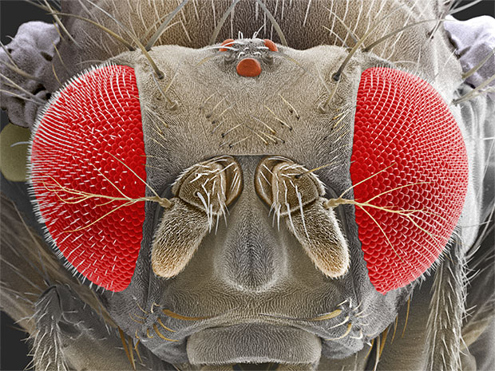
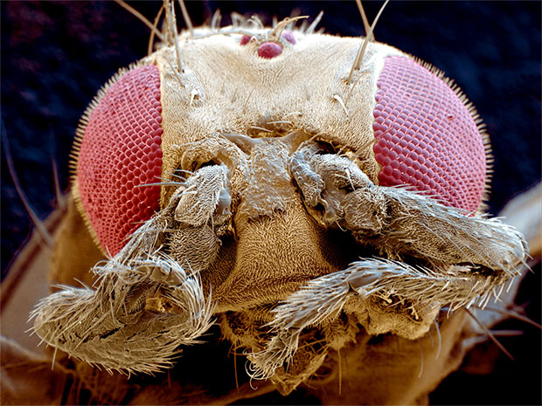
Gene Expression and Regulation
Unit 6 Lesson 3
How might changes in genes be responsible for mutations, such as the mutation that causes legs to grow in place of antennae in a fruit fly?

Slide 3
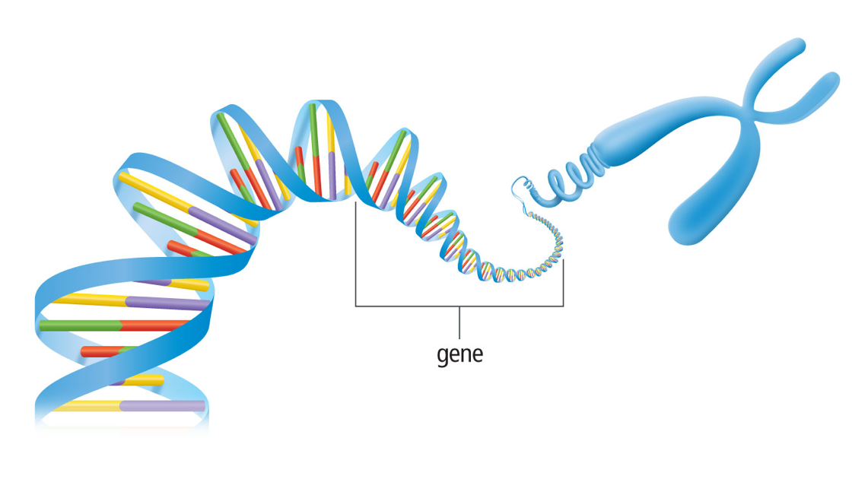
Gene Expression and Regulation
Unit 6 Lesson 3
Gene expression is the process by which the nucleotide sequence of a gene directs protein synthesis.

Slide 4
Gene Expression and Regulation Structure and Function
Unit 6 Lesson 3
EXPLAIN
Write an explanation for how differences in cell structure are related to the differences in the ways gene expression is regulated in prokaryotic and eukaryotic cells.

Slide 5
Gene Expression and Regulation
Unit 6 Lesson 3
An operon is a region of DNA that includes a promoter, an operator, and one or more structural genes that code for all the proteins needed to do a specific task.
The promoter is a segment of DNA that helps the enzyme RNA polymerase locate the starting point for transcription.
The DNA segment that actually turns genes on or off is the operator. It interacts with proteins that increase the rate of transcription or block transcription from occurring.

Slide 6

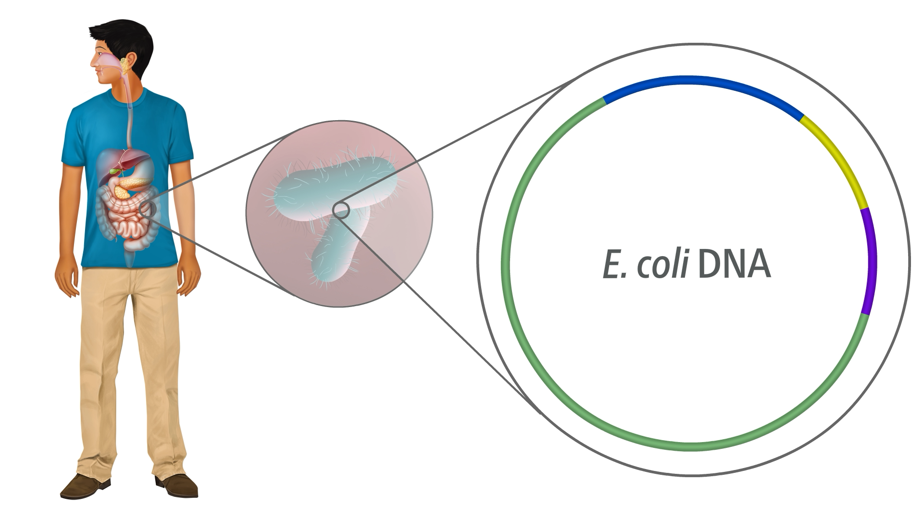
Gene Expression and Regulation
Gene regulation occurs in prokaryotes.

Slide 7

Gene Expression and Regulation Hands-On Lab: Modeling Prokaryotic Operons
Unit 6 Lesson 3
Build a model of the lac operon. Then use your model to show how gene expression is regulated in prokaryotes.

Slide 8
Gene Expression and Regulation
Unit 6 Lesson 3
MODEL
Imagine a bacterium has a mutated gene that codes for a malformed repressor protein. Draw a flow chart to show how this mutation would affect the bacterium's ability to digest lactose.

Slide 9
Gene Regulation in Eukaryotes
Unit 6 Lesson 3
Gene regulation is complex for a reason: the complexity ensures that the correct gene is expressed in the correct cell at the correct time.
When histones or DNA are changed chemically, the result may change the accessibility of the DNA for transcription.
Epigenetic changes can be caused by factors such as the age of the organism, inputs from the environment, and disease-causing organisms.

Slide 10
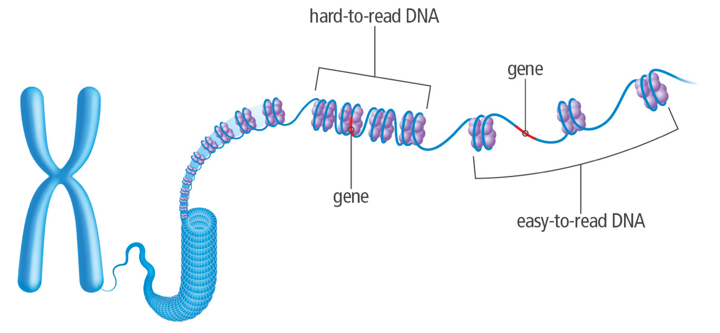
Gene Regulation in Eukaryotes
Unit 6 Lesson 3
Epigenetic changes to chromosomes occur in a variety of ways.
In one type of histone modification, the DNA molecule tightens, making it hard to read.

Slide 11
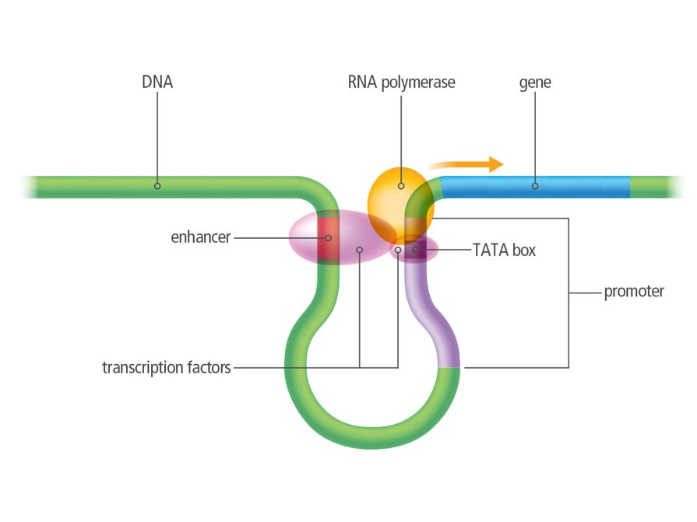
Gene Regulation in Eukaryotes
Unit 6 Lesson 3
Transcription factors are proteins that bind to DNA sequences and control gene expression.
Transcription factors may bind to a promoter, an enhancer, or other sections of DNA near a gene.

Slide 12
Gene Regulation in Eukaryotes
Unit 6 Lesson 3
EXPLAIN
Transcription factors occur in different combinations in different types of cells. How does this allow for variety in cell types?

Slide 13
Gene Regulation in Eukaryotes Engineering: Using RNA Interference to Fight Disease
Unit 6 Lesson 3
Huntington's disease is an inherited disorder that affects the nervous system, resulting in loss of coordination and declining brain function.
This disease has been linked to a mutation in the HTT gene. Imagine you want to design an RNAi technology to silence this gene.
Make a list of questions you would need to ask to define and delimit the problem.

Slide 14
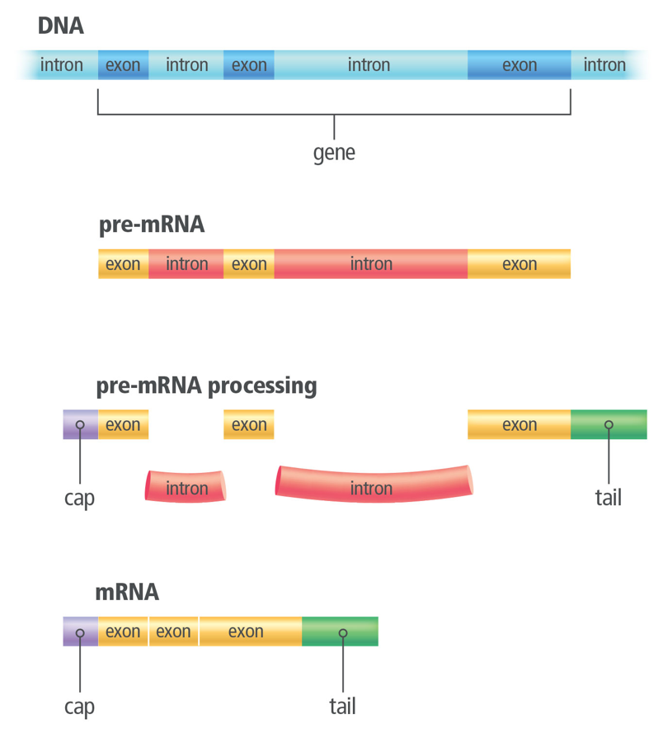
Gene Regulation in Eukaryotes
Unit 6 Lesson 3
The "extra footage" in the mRNA molecule takes the form of nucleotide segments, called introns, that are not included in the final protein.
The nucleotide segments that code for parts of the protein are called exons. Introns occur between exons.

Slide 15
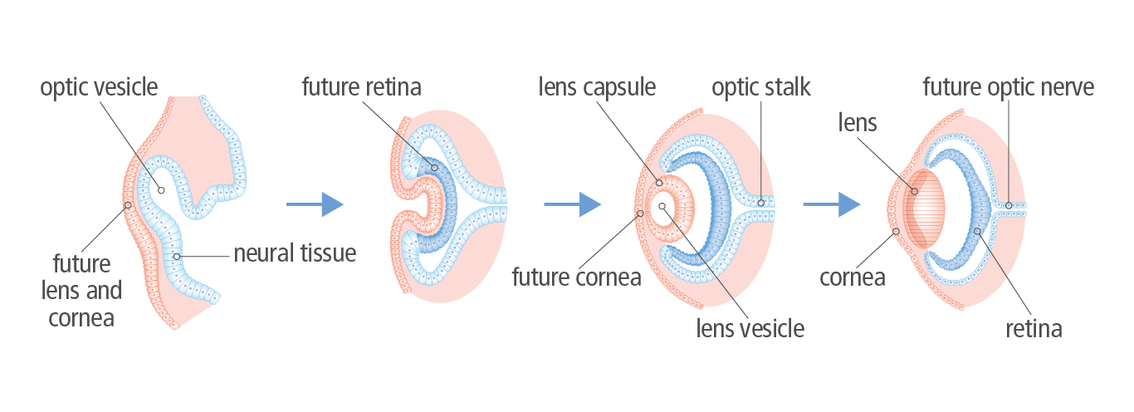
Factors That Influence Gene Expression
Unit 6 Lesson 3
During embryonic development, cell differentiation and growth form tissues and organs, such as the eye.

Slide 16
Factors That Influence Gene Expression Structure and Function
Unit 6 Lesson 3
Make a claim for how the cells in an organism can take on different structures and functions even though they all have the same genetic material.

Slide 17

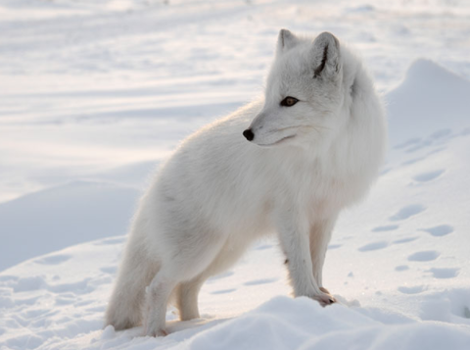
Factors That Influence Gene Expression
Unit 6 Lesson 3
Factors in an organism's external environment can also affect gene expression.
Environmental factors, such as light and temperature, can affect gene expression.
Compare Arctic fox fur color expression during summer and winter months.

Slide 18
Factors That Influence Gene Expression
Unit 6 Lesson 3
EXPLAIN
Researchers have found that cancerous tumor tissue is often hypoxic, or deficient in oxygen. As a result, HIF is currently being considered as a possible tool in the fight against cancer. Explain how HIF-related approaches could be used to suppress tumor growth, and how this is related to regulating gene expression.

Slide 19
Unit 6 Lesson 3
Continue Your Exploration
Choose one of the paths below to continue your exploration:
Career: Geneticist
“Junk” DNA
Twins: Are They Exactly the Same?
Genes: Life After Death

Slide 20
Can You Explain It?
Unit 6 Lesson 3
Refer to the notes in your Evidence Notebook to explain why a mutation in Hox genes results in structural malformations. In your explanation, answer the following questions:
How do transcription factors regulate gene expression in eukaryotes? Make a model illustrating the process, and write an explanation to accompany your model.
Why does a mutation in the Antennapedia gene affect body development in this way? How is this change in structure related to the regulation of gene expression?

Slide 21
Image Credits
Unit 6 Lesson 3
Arctic fox in field ©BMJ/Shutterstock; Arctic fox in snow ©E+/DmitryND/Getty Images; fruit fly ©Andrew Syred/Science Source

